Slide 1
Chapter – 9 Document Databases

Slide 2

What Is a Document Database?
Documents are the main concept in document databases. The database stores and retrieves documents, which can be XML, JSON, BSON, and so on.
These documents are self-describing, hierarchical tree data structures which can consist of maps, collections, and scalar values. The documents stored are similar to each other but do not have to be exactly the same.
Document databases store documents in the value part of the key-value store; think about document databases as key-value stores where the value is examinable.

Slide 3
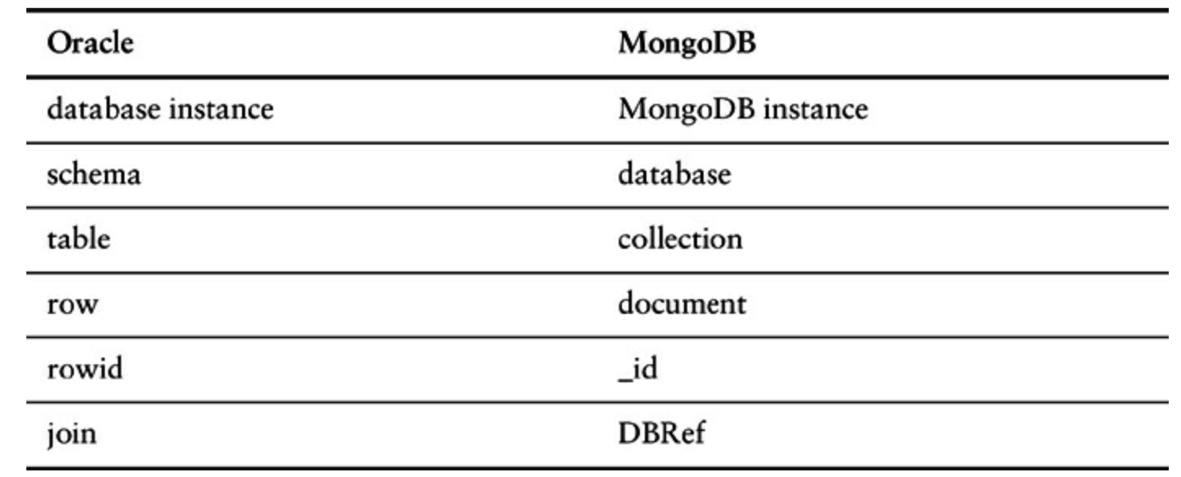
What Is a Document Database?
Let’s look at how terminology compares in Oracle and MongoDB.

Slide 4
What Is a Document Database?
{ "firstname": "Martin",
"likes": [ "Biking", "Photography" ], "lastcity": "Boston", "lastVisited": }
The above document can be considered a row in a traditional RDBMS. Let’s look at another document:
{ "firstname": "Pramod",
"citiesvisited": [ "Chicago", "London", "Pune", "Bangalore" ],
"addresses": [
{ | "state": "city": | "AK", "DILLINGHAM",
 | "type": | "R" },
{ | "state": | "MH",
 | "city": "type": | "PUNE", "R" } ],
"lastcity": "Chicago" }

Slide 5
What Is a Document Database?
Looking at the documents, we can see that they are similar, but have differences in attribute names. This is allowed in document databases. The schema of the data can differ across documents, but these documents can still belong to the same collection unlike an RDBMS where every row in a table has to follow the same schema.
In documents, there are no empty attributes; if a given attribute is not found, we assume that it was not set or not relevant to the document. Documents allow for new attributes to be created
without the documents.
Examples
need to define them or to change the existing
of document databases: MongoDB, CouchDB,
Terrastore, OrientDB, RavenDB and Lotus Notes

Slide 6
Features
Each MongoDB instance has multiple databases, and each database can have multiple collections.
When we store a document, we have to choose which database and collection this document belongs to. Some of the features are:
Consistency
Transactions
Availability
Query features
Scaling

Slide 7
Consistency
Consistency in MongoDB database is configured by using the replica sets and choosing to wait for the writes to be replicated to all the slaves or a given number of slaves. Every write can specify the number of servers the write has to be propagated to before it returns as successful.
A command like
db.runCommand({ getlasterror : 1 , w : "majority" })
tells the database how strong is the consistency you want.

Slide 8
Consistency
Ex: if you have one server and specify the w as majority, the write will return immediately since there is only one node.
If you have three nodes in the replica set and specify w as majority, the write will have to complete at a minimum of two nodes before it is reported as a success.
You can increase the w value for stronger consistency but you will suffer on write performance, since now the writes have to complete at more nodes.

Slide 9
Consistency
Replica sets also allow you to increase the read performance by allowing reading from slaves by setting slaveOk; this parameter can be set on the connection, or database, or collection, or individually for each operation.
Mongo mongo = new Mongo("localhost:27017"); mongo.slaveOk();
Here we are setting slaveOk per operation, so that we can decide which operations can work with data from the slave node.

Slide 10
Consistency
By default, a write is reported successful once the database receives it; you can change this so as to wait for the writes to be synced to disk or to propagate to two or more slaves. This is known as WriteConcern: You make sure that certain writes are written to the master and some slaves by setting WriteConcern to REPLICAS_SAFE.
Shown below is code where we are setting the WriteConcern
for all writes to a collection:
DBCollection shopping = database.getCollection("shopping"); shopping.setWriteConcern(REPLICAS_SAFE);

Slide 11
Consistency
Based on your application needs and business requirements, to decide what settings make sense for slaveOk during read or what safety level you desire during write with WriteConcern.

Slide 12
Transactions
Transactions, in the traditional RDBMS sense, mean that you can start modifying the database with insert, update, or delete commands over different tables and then decide if you want to keep the changes or not by using commit or rollback.
These constructs are generally not available in NoSQL solutions—a write either succeeds or fails. Transactions at the single-document level are known as atomic transactions.

Slide 13
Transactions
By default, all writes are reported as successful. A finer
control over the write can be achieved by using
WriteConcern parameter.
Different levels of WriteConcern let you choose the safety level during writes; for example, when writing log entries, you can use lowest level of safety, WriteConcern.NONE.

Slide 14
Availability
The CAP theorem dictates that we can have only two of Consistency, Availability, and Partition Tolerance.
Document databases try to improve on availability by replicating data using the master-slave setup. MongoDB implements replication, providing high availability using replica sets.
In a replica set, there are two or more nodes participating in an asynchronous master-slave replication.
The replica-set nodes elect the master, or primary, among themselves.

Slide 15
Availability
Assuming all the nodes have equal voting rights, some nodes can be favored for being closer to the other servers, for having more RAM, and so on; users can affect this by assigning a priority—a number between 0 and 1000—to a node.
All requests go to the master node, and the data is replicated to the slave nodes. If the master node goes down, the remaining nodes in the replica set vote among themselves to elect a new master;
When the node that failed comes back online, it joins in as a slave and catches up with the rest of the nodes by pulling all the data it needs to get current.

Slide 16
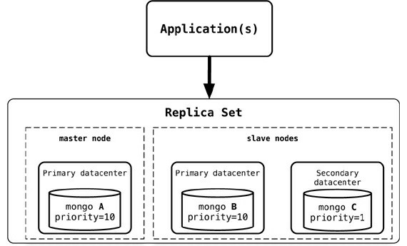
Availability
Replica set configuration with higher priority assigned to nodes in the same data center

Slide 17
Availability
Replica sets are generally used for data redundancy, automated failover, read scaling, server maintenance without downtime, and disaster recovery.
Similar availability setups can be achieved with CouchDB, RavenDB, Terrastore, and other products.

Slide 18
Query Features
Document databases provide different query features. CouchDB allows you to query via views. With CouchDB, if you need to aggregate the number of reviews for a product as well as the average rating, you could add a view implemented via map-reduce to return the count of reviews and the average of their ratings.
When there are many requests, you can add a materialized view that precomputes the values and stores the results in the database. These materialized views are updated when queried, if any data was changed since the last update.

Slide 19
Query Features
One of the good features of document databases, as compared to key-value stores, is that we can query the data inside the document without having to retrieve the whole document by its key and then introspect the document.
Let’s look at certain queries that we can do against MongoDB.
Suppose we want to return all the documents in an order collection. The SQL for this would be:
SELECT * FROM order
The equivalent query in Mongo shell would be:
db.order.find()

Slide 20
Query Features
Selecting the orders for a single customerId of
883c2c5b4e5b would be:
SELECT * FROM order WHERE customerId = "883c2c5b4e5b"
The equivalent query in Mongo to get all orders for a single customerId of 883c2c5b4e5b: db.order.find({"customerId":"883c2c5b4e5b"})
Similarly, selecting orderId and orderDate for one
customer in SQL would be:
SELECT orderId,orderDate FROM order WHERE
customerId = "883c2c5b4e5b"
and the equivalent in Mongo would be:
db.order.find({customerId:"883c2c5b4e5b"},{orderId
:1,orderDate:1})

Slide 21
Query Features
Since the documents are aggregated objects, it is really easy to query for documents that have to be matched using the fields with child objects.
Let’s say we want to query for all the orders where one of the items ordered has a name like Refactoring. The SQL for this requirement
would be:
SELECT * FROM customerOrder, product WHERE customerOrder.orderId = orderItem.customerOrderId AND
orderItem,
orderItem.productId = product.productId AND product.name LIKE '%Refactoring%’
and the equivalent Mongo query would be: db.orders.find({"items.product.name":/Refacto ring/})

Slide 22
Scaling
Scaling for heavy-read loads can be achieved by adding more read slaves, so that all the reads can be directed to the slaves.
Given a heavy-read application, with our 3-node replica-set cluster, we can add more read capacity to the cluster as the read
load increases just by adding more slave nodes to the replica set to execute reads.
This is horizontal scaling for reads.
Once the new node, mongo D, is started, it needs to be added to the replica set.
When a new node is added, it will sync up with the existing
nodes, join the replica set as secondary node, and start serving read requests. An advantage of this setup is that we do not have to restart any other nodes, and there is no downtime for the application either.

Slide 23
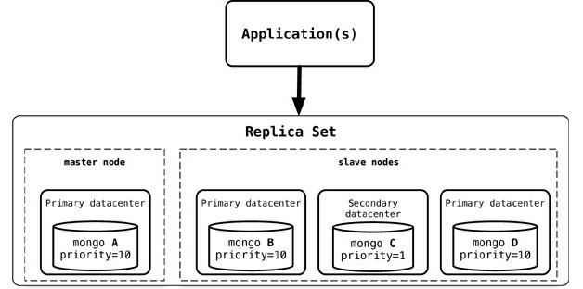
Scaling
Adding a new node, mongo D, to an existing replica-set cluster

Slide 24
Suitable Use Cases
Event Logging: Applications have different event logging needs; within the enterprise, there are many different applications that want to log events. Document databases can store all these different types of events and can act as a central data store for event storage.
Content Management Systems, Blogging Platforms: Since document databases have no predefined schemas and usually
understand JSON documents, they work well in content management systems or applications for publishing websites, managing user comments, user registrations, profiles, web-facing documents.
Web Analytics or Real-Time Analytics: Document databases can store data for real-time analytics without schema changes.

Slide 25
Suitable Use Cases
E-Commerce Applications: E-commerce applications often need to have flexible schema for products and orders

Slide 26
When Not to Use
Complex Transactions Spanning Different Operations: If you need to have atomic cross-document operations, then document databases may not be for you. However, there are some document databases that do support these kinds of operations, such as RavenDB.
Queries against Varying Aggregate Structure: Since the data is saved as an aggregate, if the design of the aggregate is constantly changing, you need to save the aggregates at the lowest level of granularity—basically, you need to normalize the data. In this scenario, document databases may not work.

Slide 27

THANK YOU

